Slide 1
100%ATTENDANCE
B.RAMANJINEYULU CH.SRIRAMALAXMI V.KONDALARAO
B.SATISH N.SEETHARATHNAM D.NARENDRA
V.ANJALI P.MANIKUMARI D.NAGALAKSHMI
G.RAJASEKHAR M.RATHNAKUMARI CH.RAMALAKSHMI
G.KIRANMAI K.SATYA S.ARUNAKUMARI
K.PURNACHANDRARAO PUNYAVATHI T.ANASUYA
A.SRINIVASARAO KANCHANA K.LALITHA
M.RAMBABU LAXMI SURI K.KOTESWARARAO
M.RAVIKISHORE RAGHAVEENA T.NAGAMANI
S YADESH N.VENKATA LAXMI
A.DIVYA SUBHASHINI
M.RUKMINI SRIDEVI
A.SWATHI N.LAKSHMI
P.ANU B.NAGAMANI
N.SUJATHA P.APPARAO
Y.DEVI K.KOTESWARARAO
A.KUSUMA B.SRINU

Slide 2
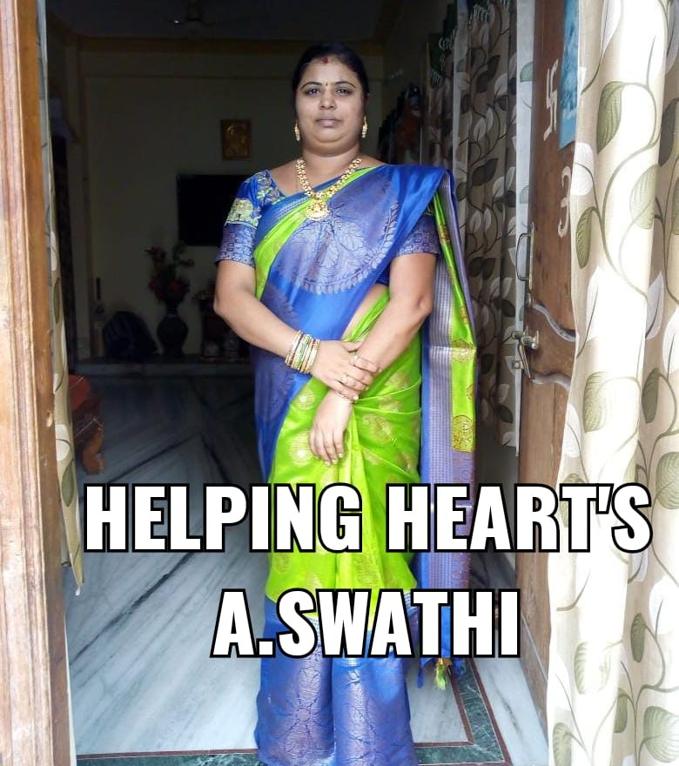
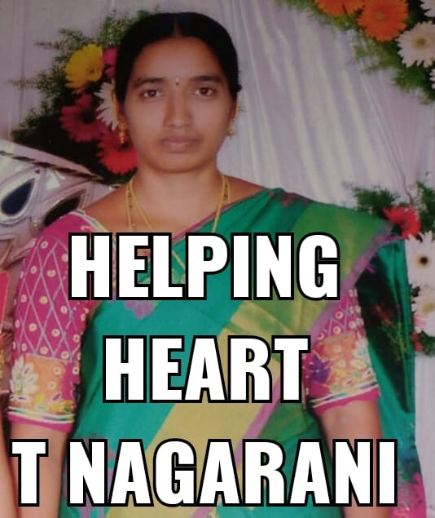
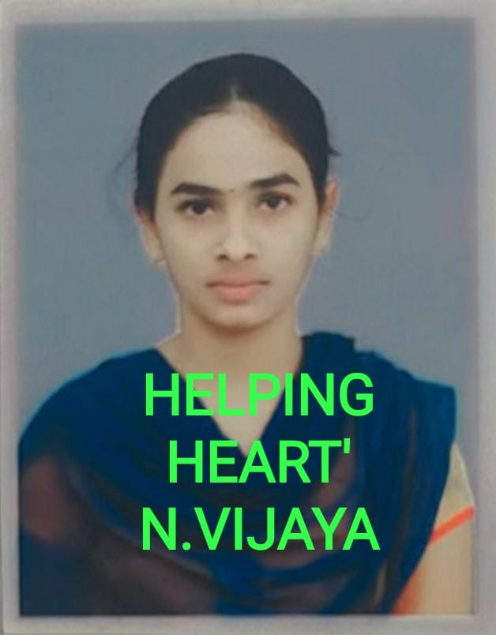
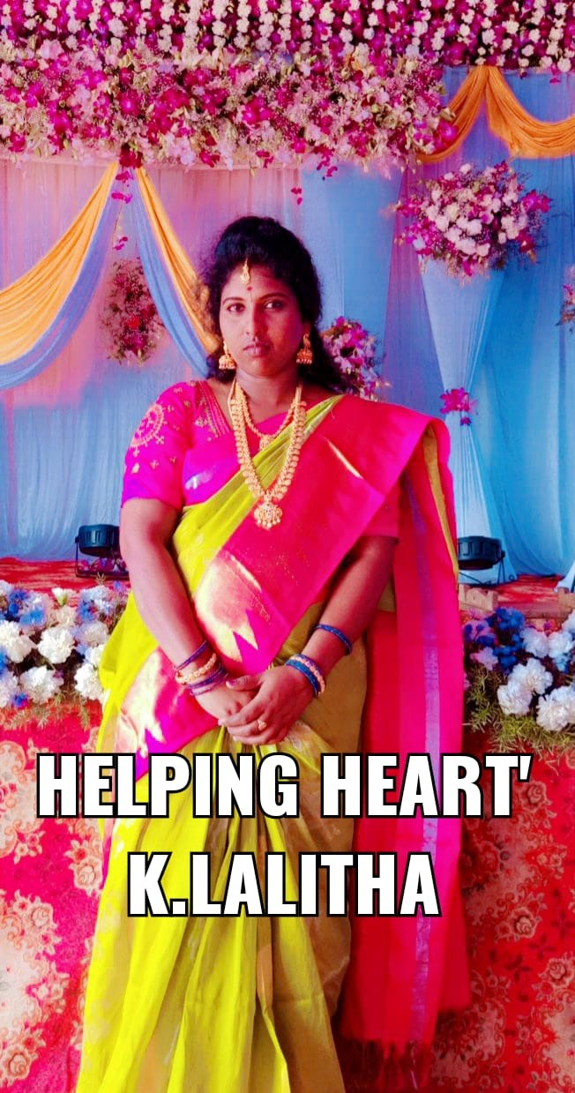
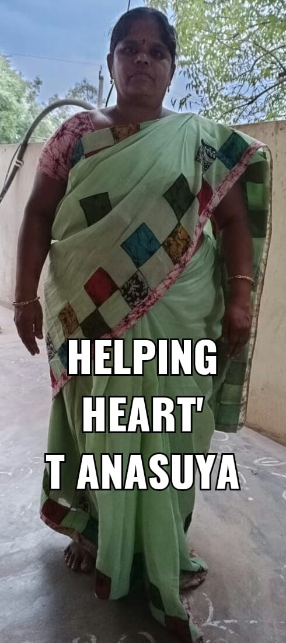
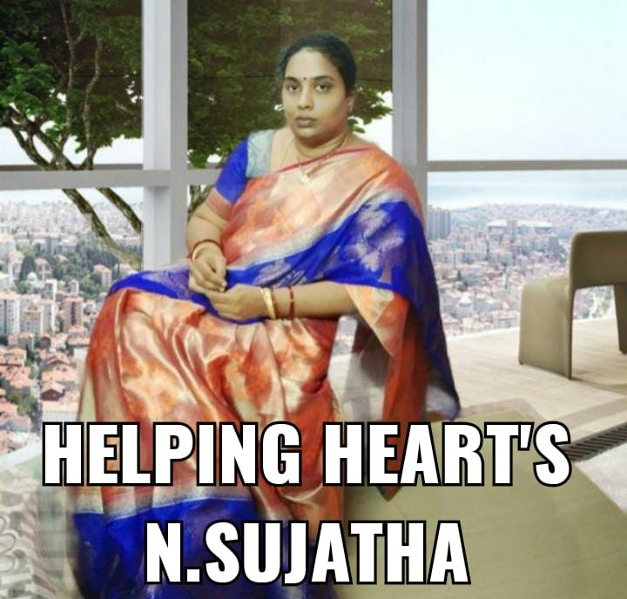
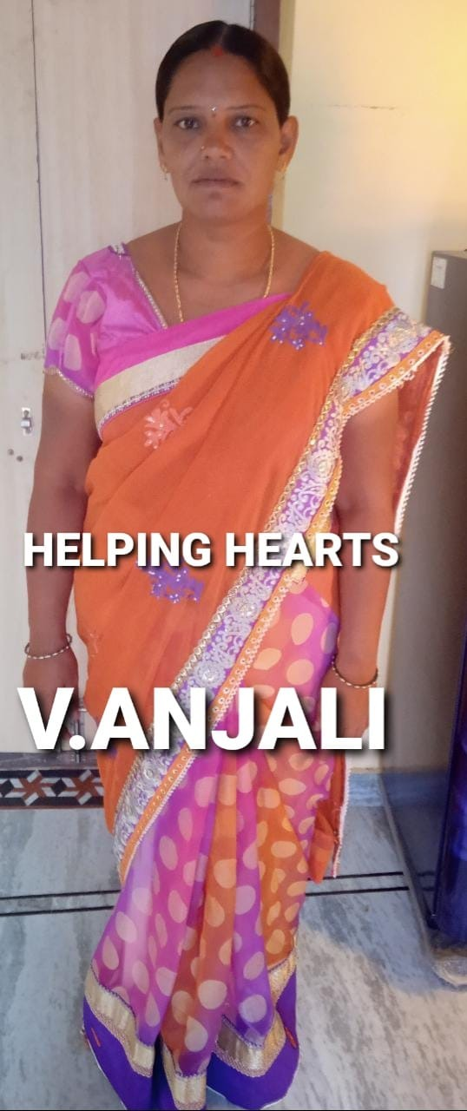
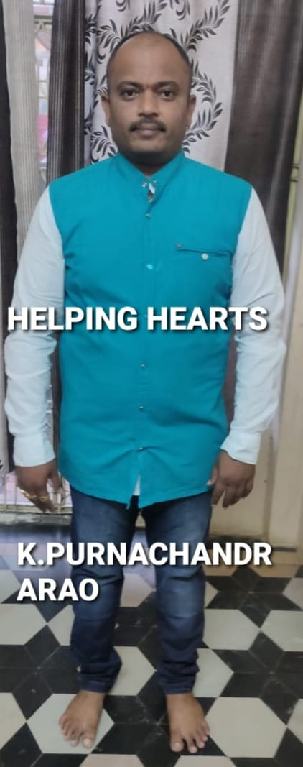
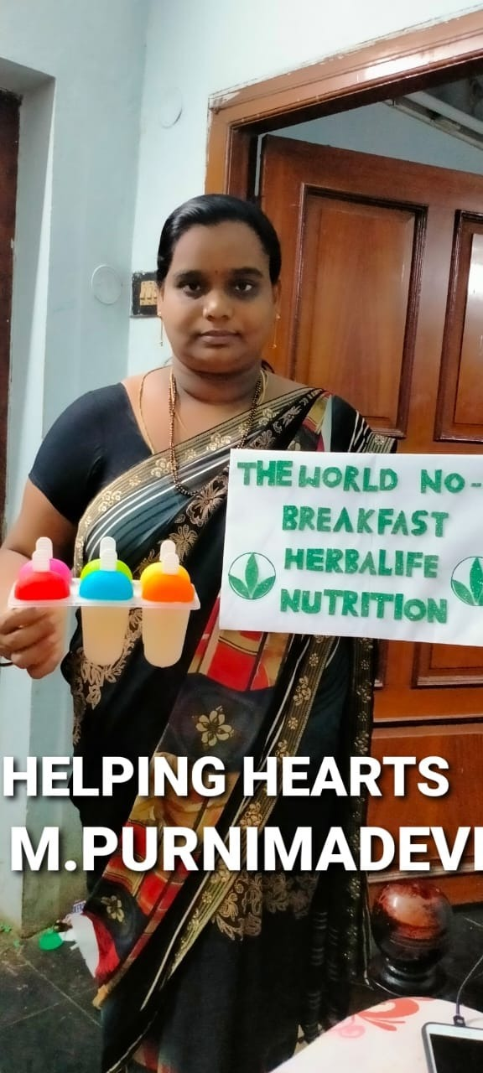
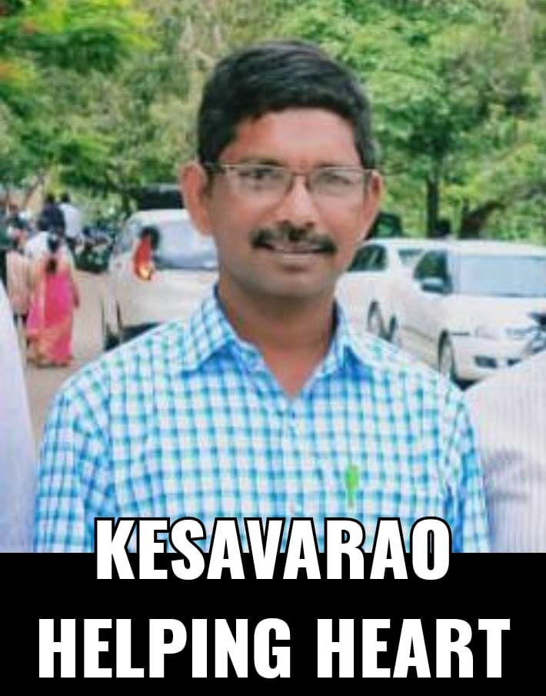
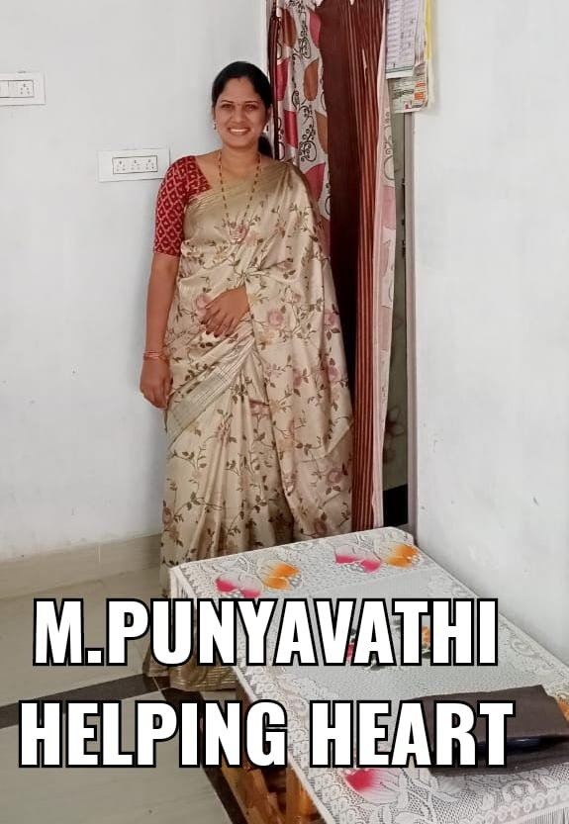
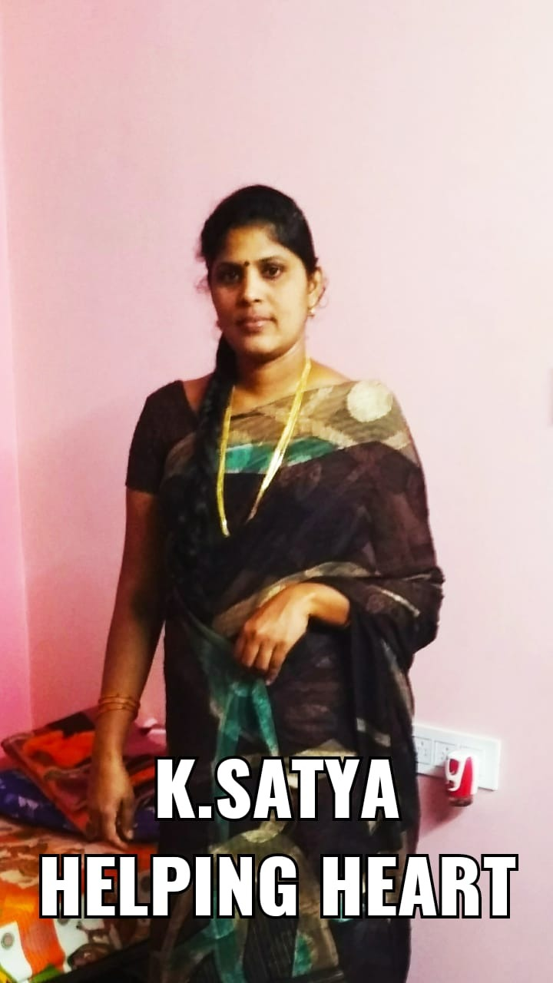
HELPING HEART

Slide 3
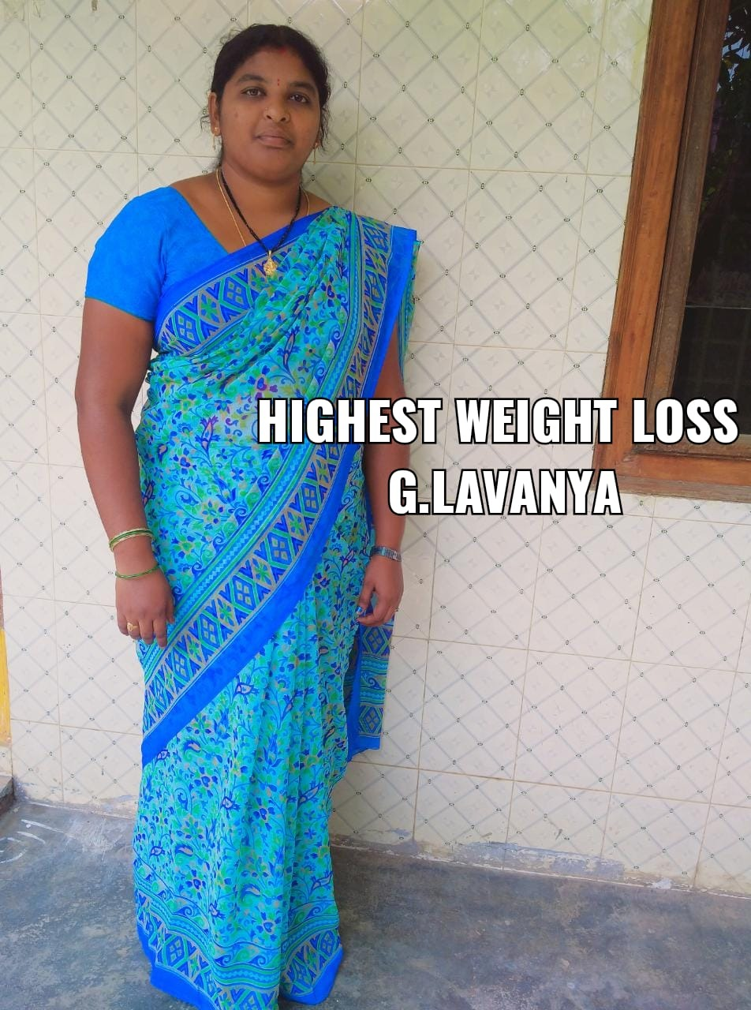
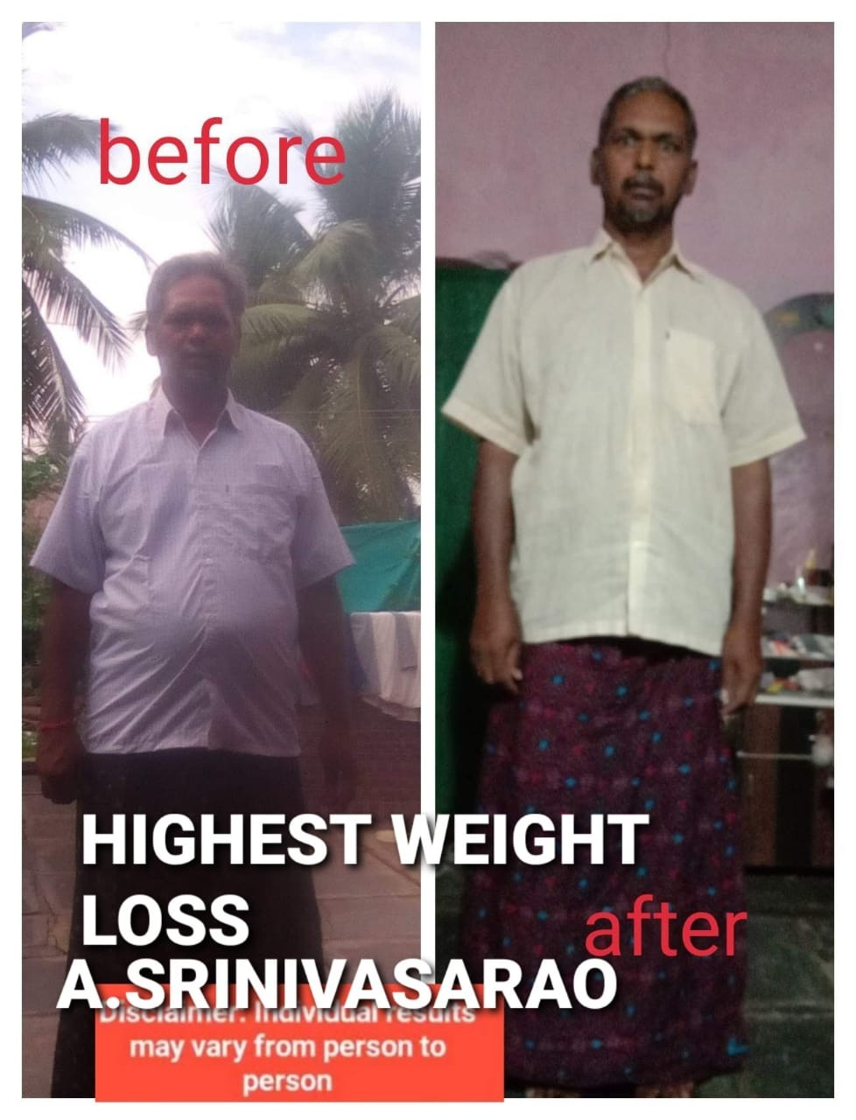
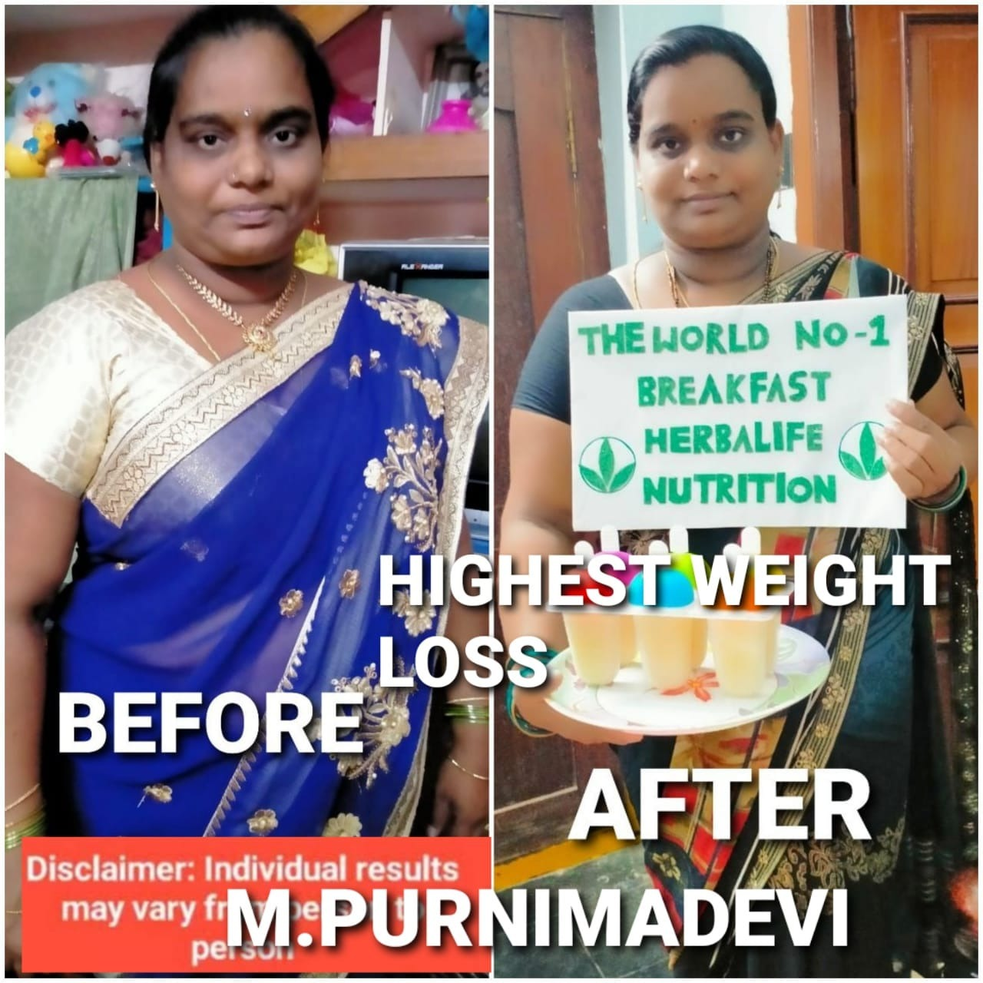
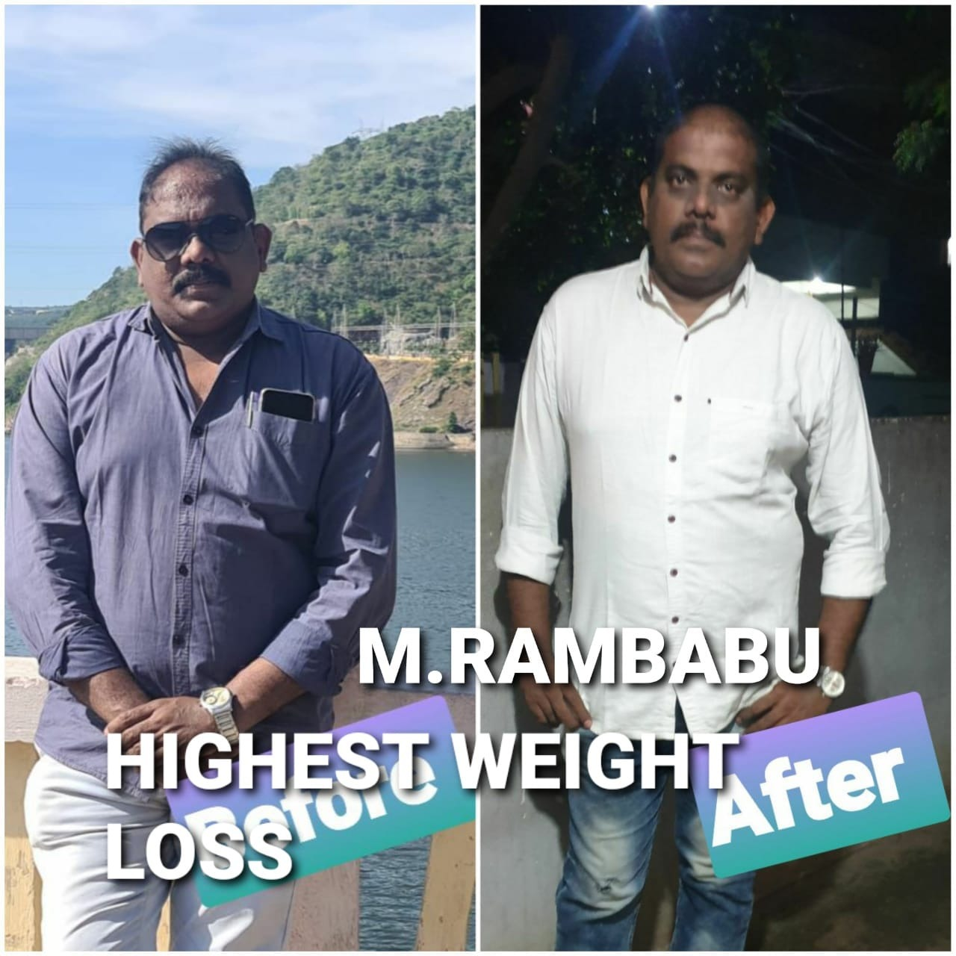
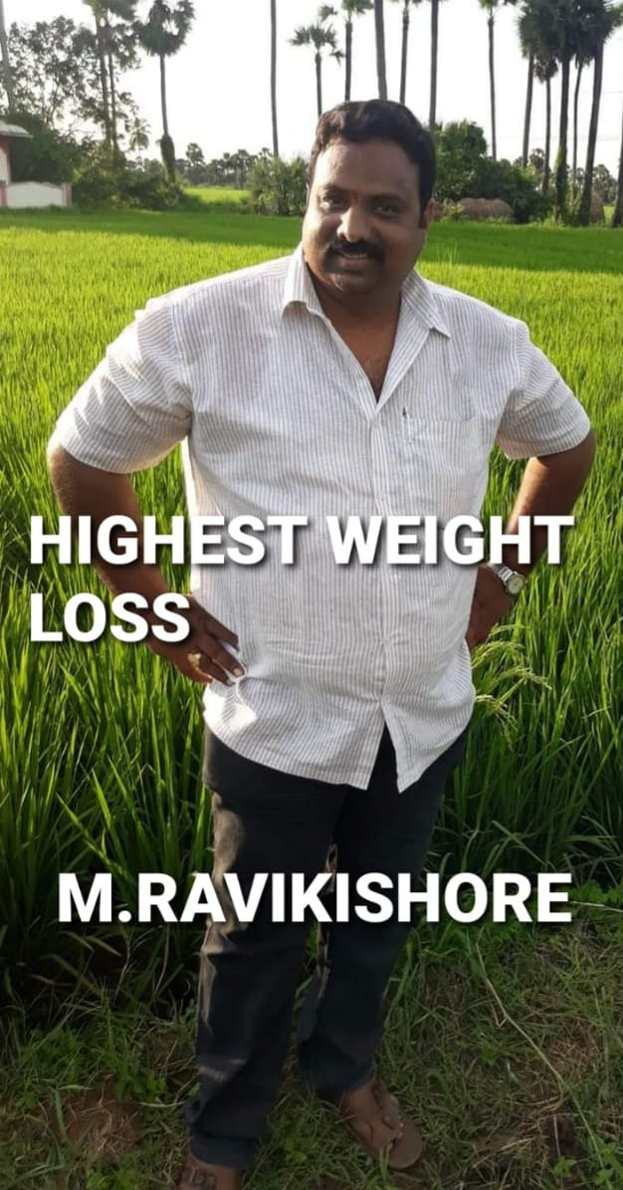
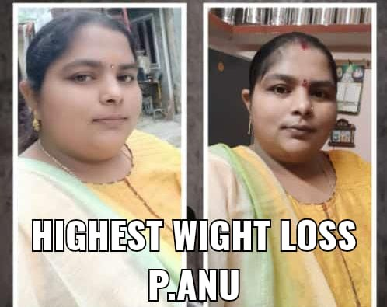
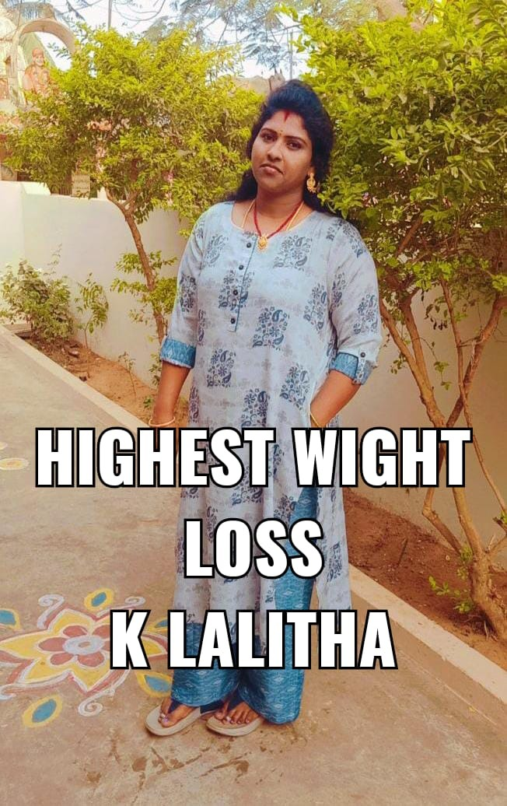
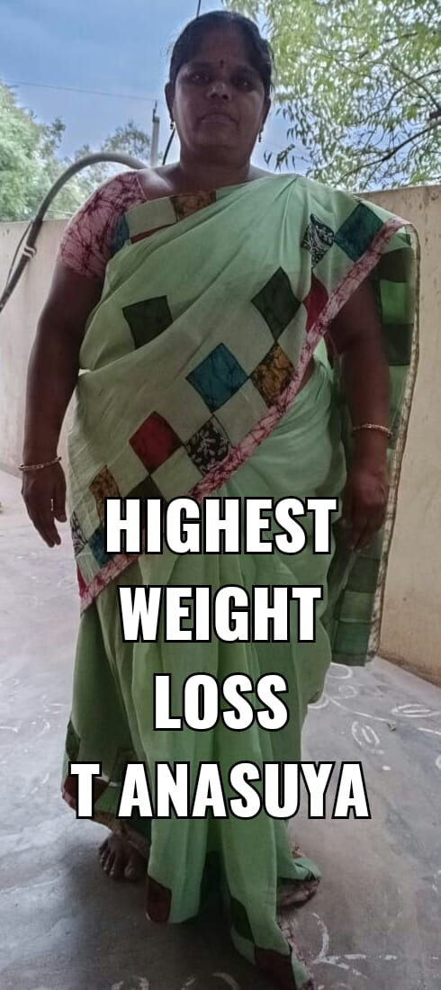
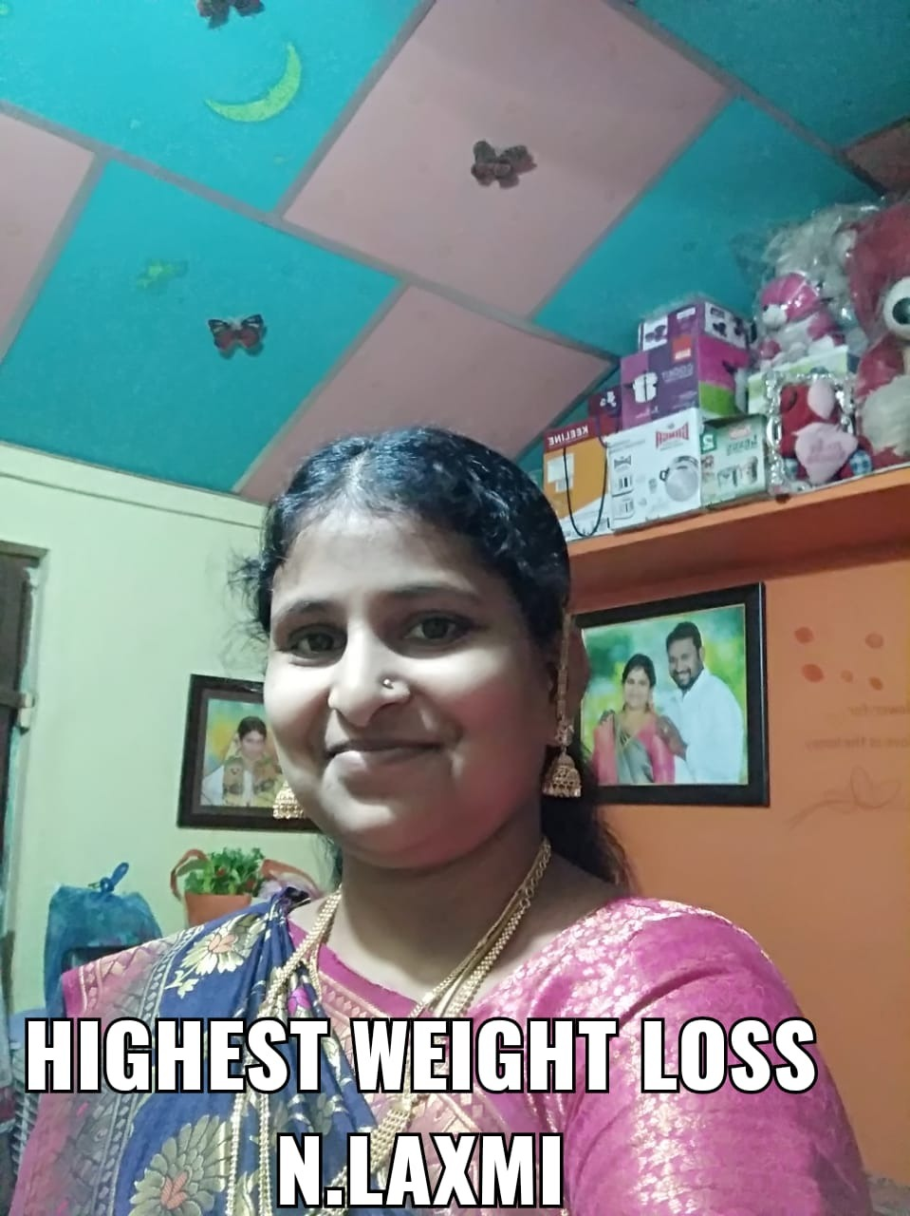
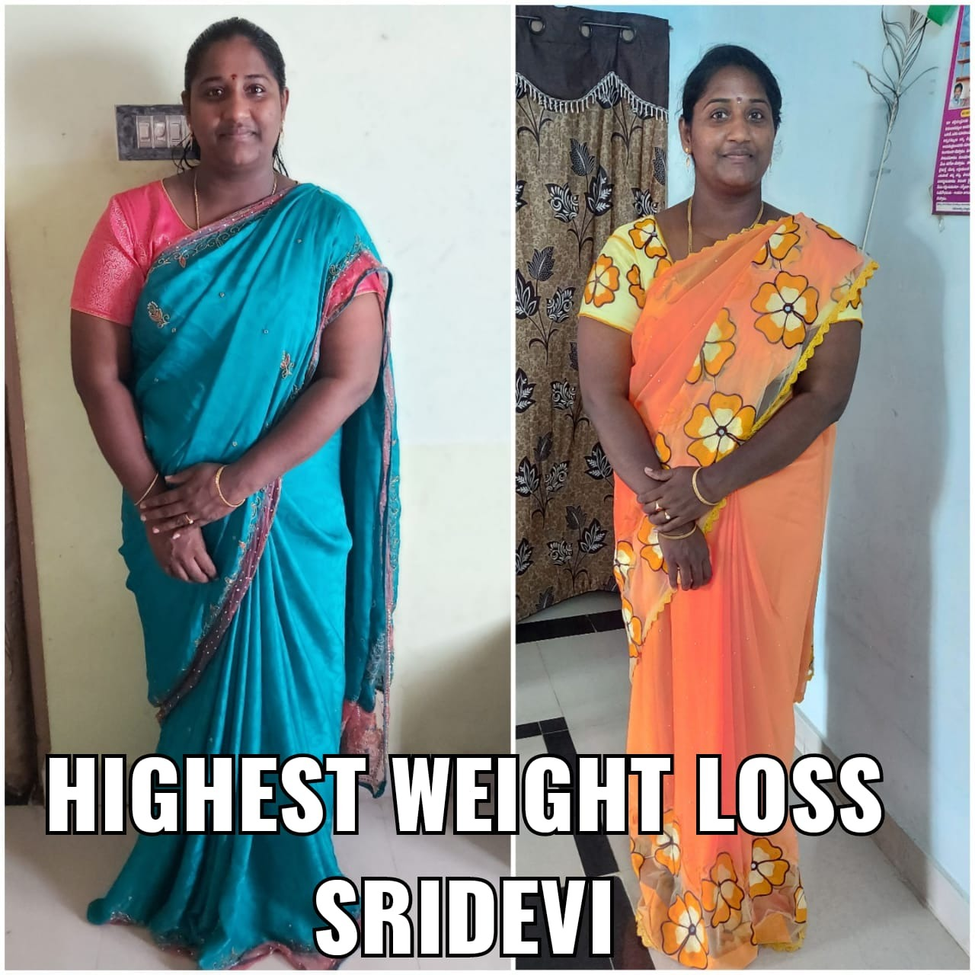
HIGHEST WEIGHT LOSS

Slide 4
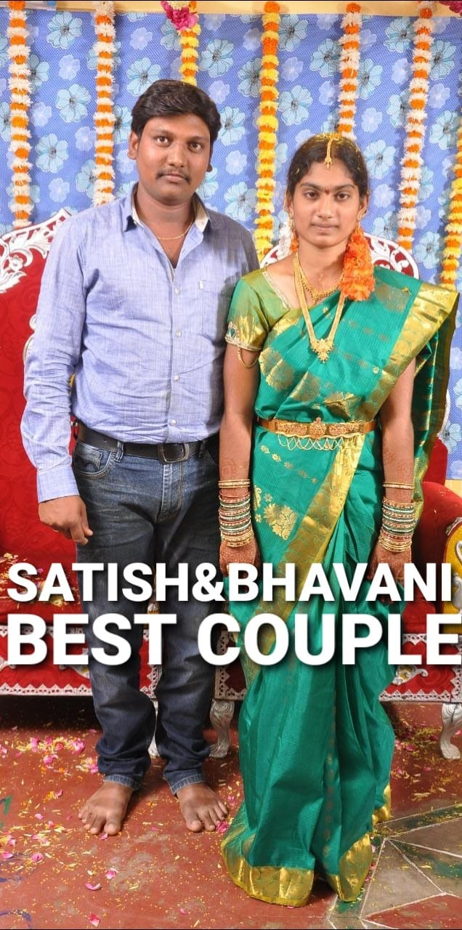
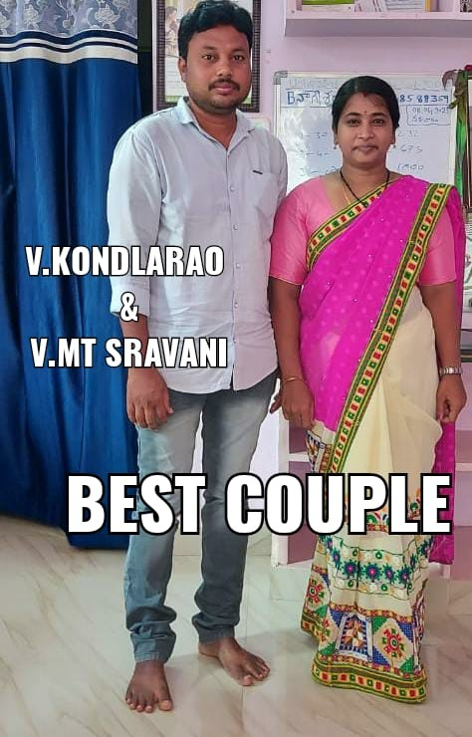
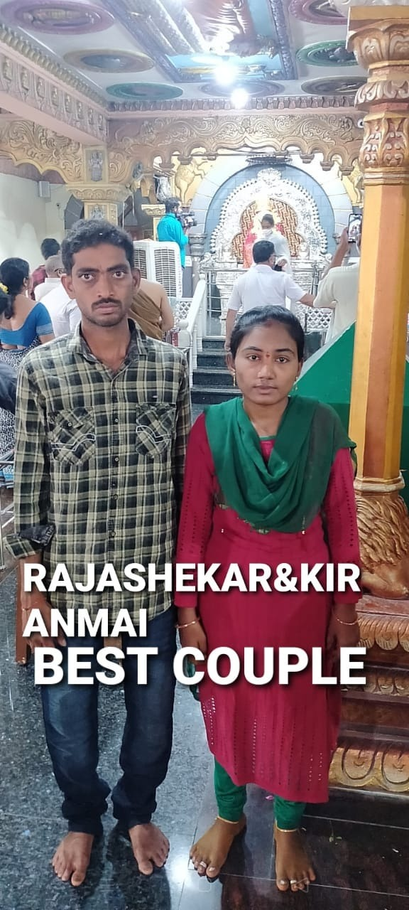
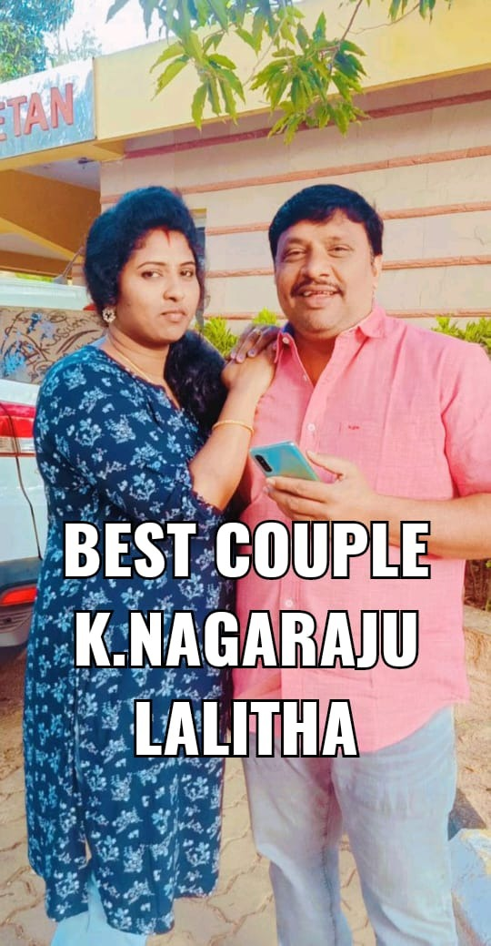
BEST COUPLE

Slide 5
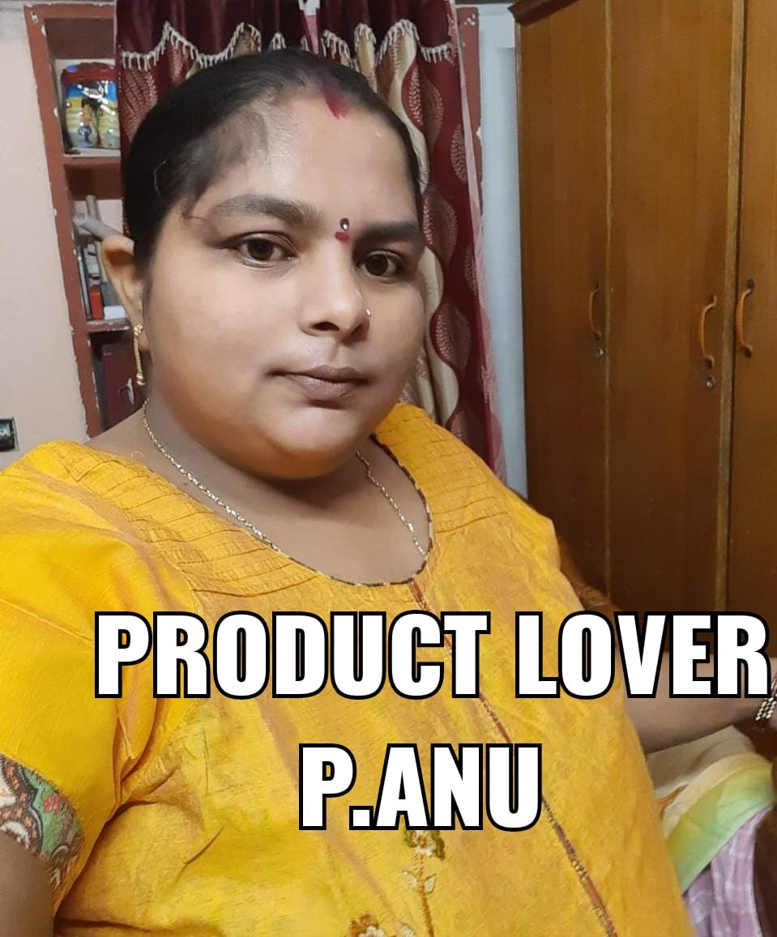
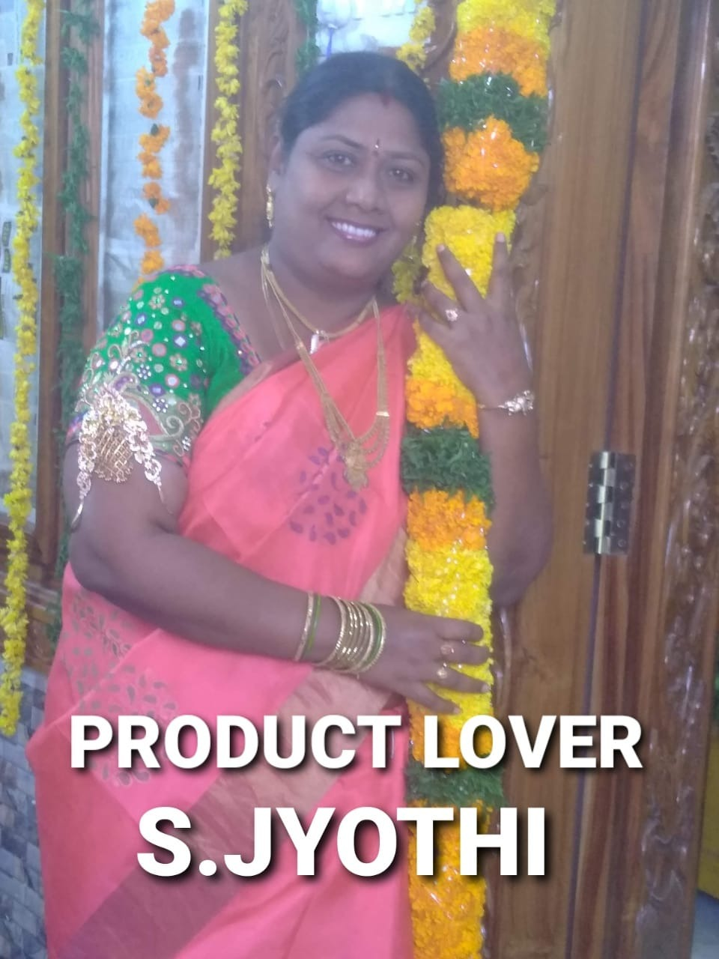
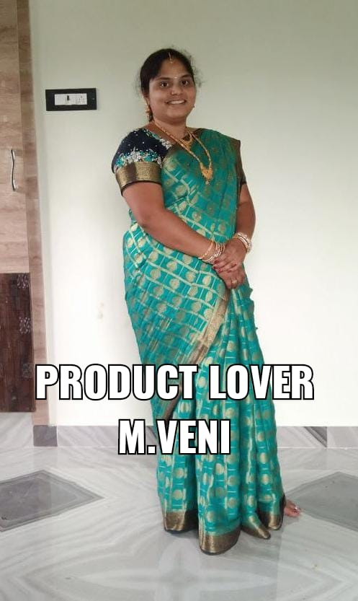
PRODUCT LOVER

Slide 6
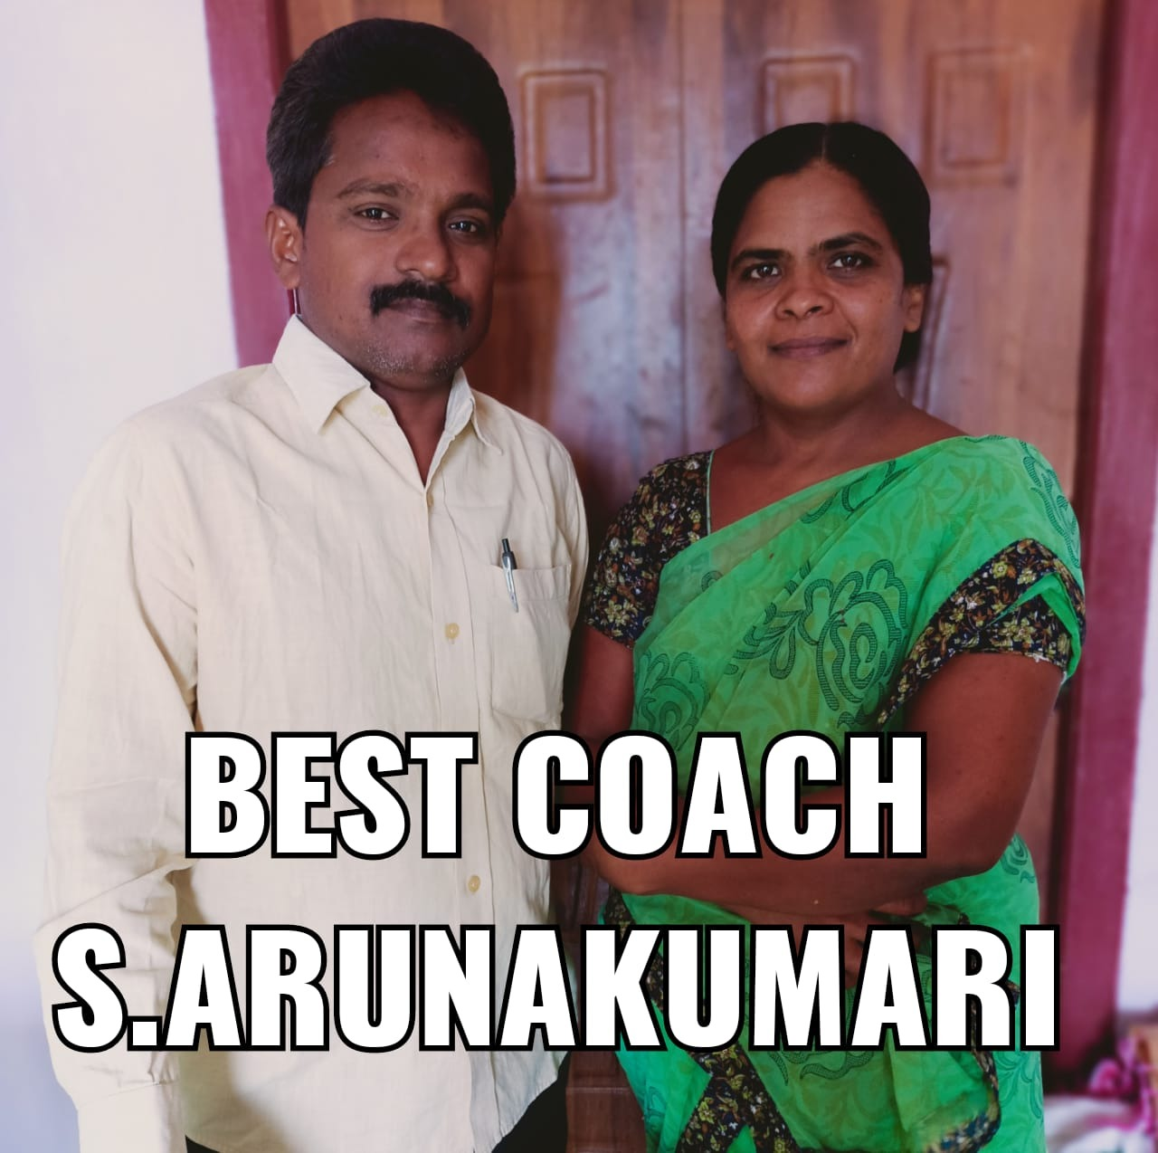
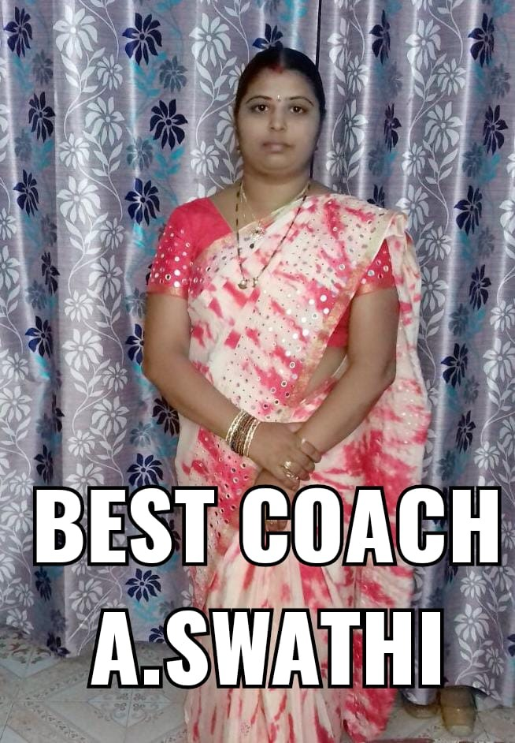
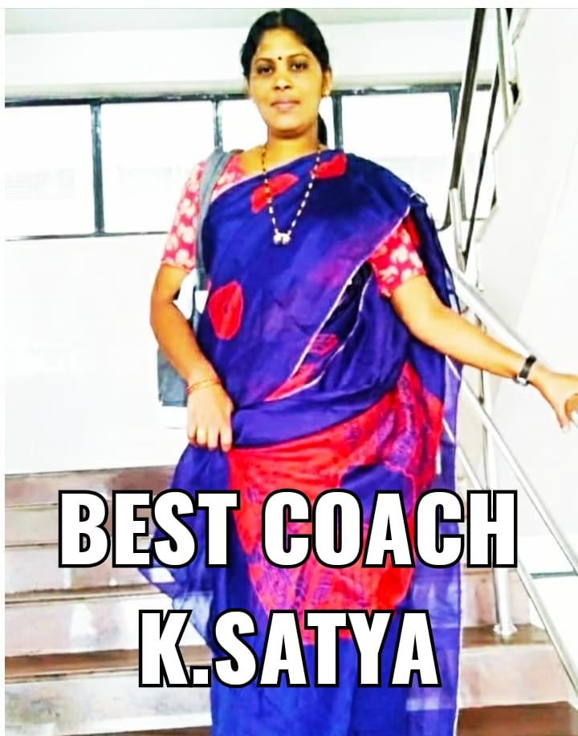
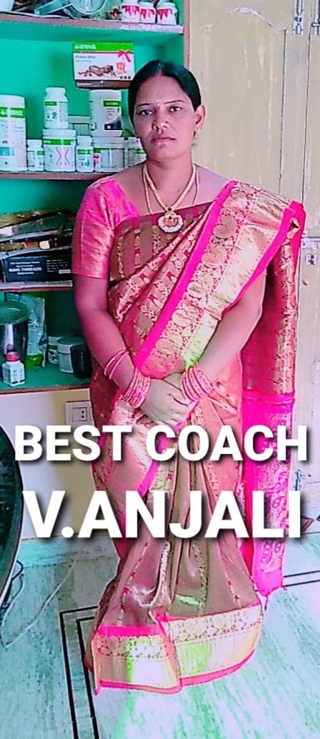
BEST COACH

